Slide 1
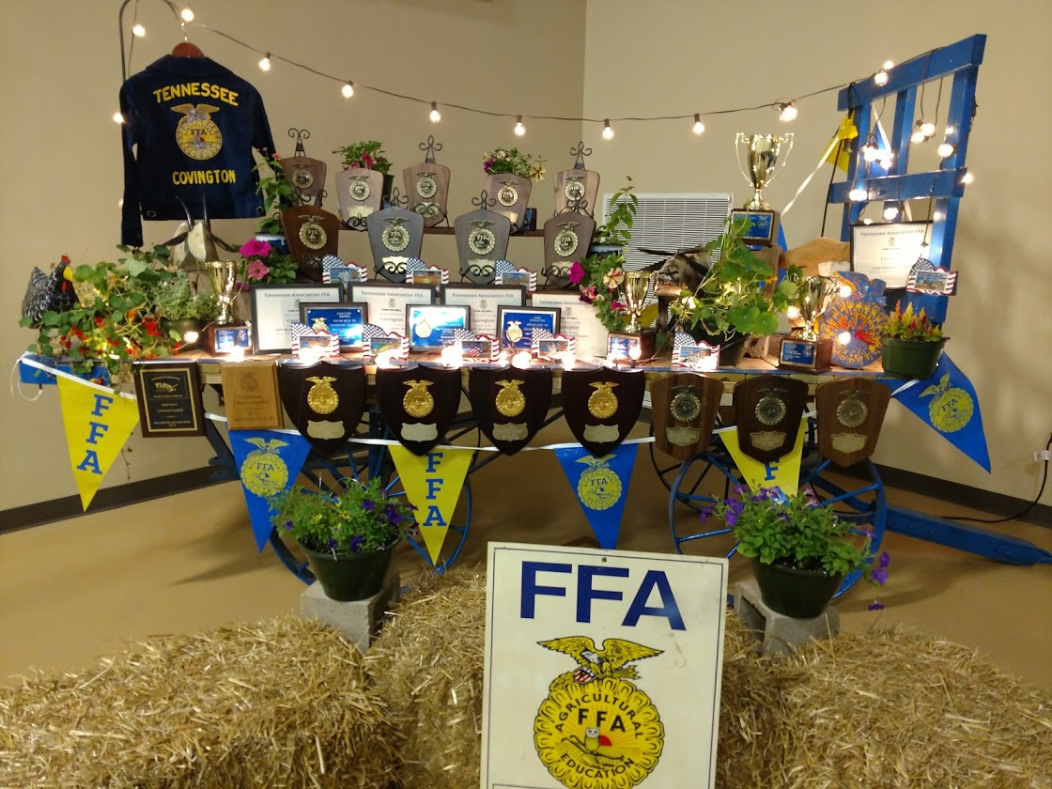
Why Be Active in the Covington FFA? 2023-2024
Mr. Johnson
Covington Ag Department

Slide 3
2023-2024 Covington FFA Officers
President=Sydnie True
Vice-President= Dakota Greve, TJ Jones, Ethan Yarbro
Secretary= Erin Grisham
Treasurer= Matthew Kurrus
Reporter= Baylea Walton
Sentinel= Tristan Martin
Chaplain= Connor Leland

Slide 4
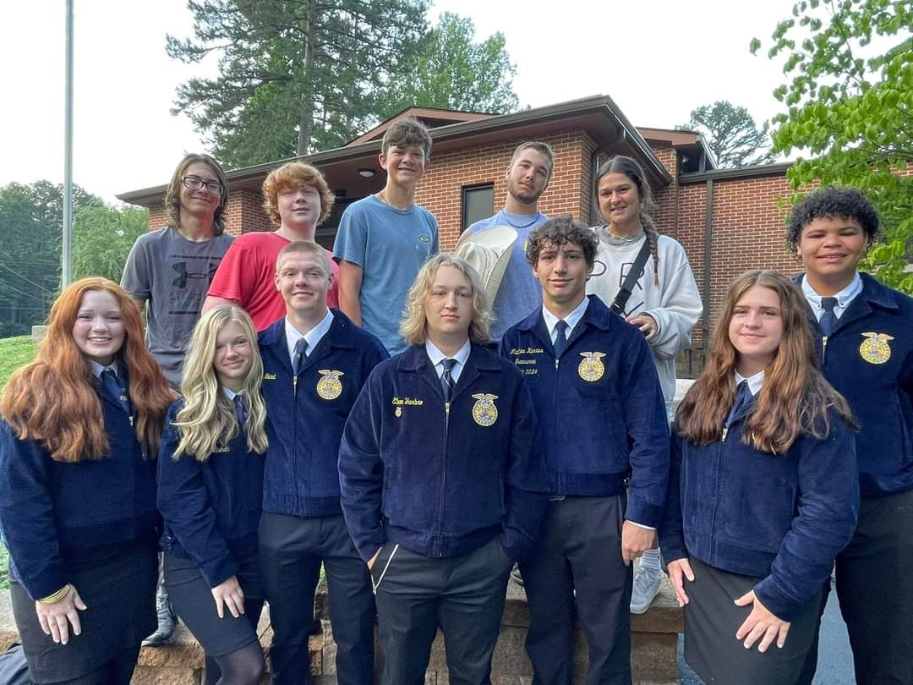

Slide 5
COVINGTON ffa aDVISORS
Mrs. Flanagan=Greenhouse, State Dual Credit Plant and Soil Science, Leadership, and Landscaping
Mr. Cole= Applied Environmental Science, Agriculture Business (Personal Finance), Small Animal Care, and Vet-Science
Mr. Johnson=Digital Agronomy, Welding, Wildlife Management, and Agriculture Mechanics

Slide 6
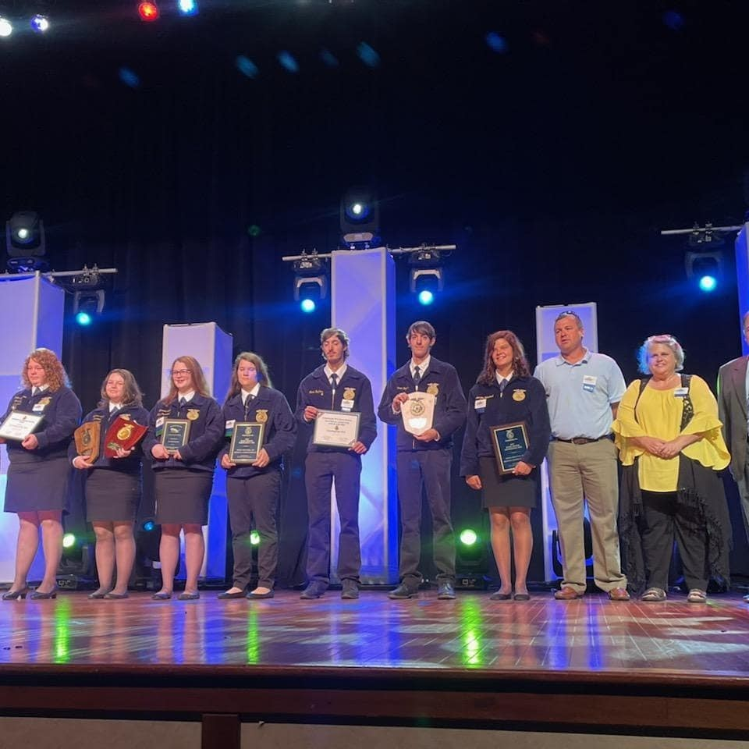
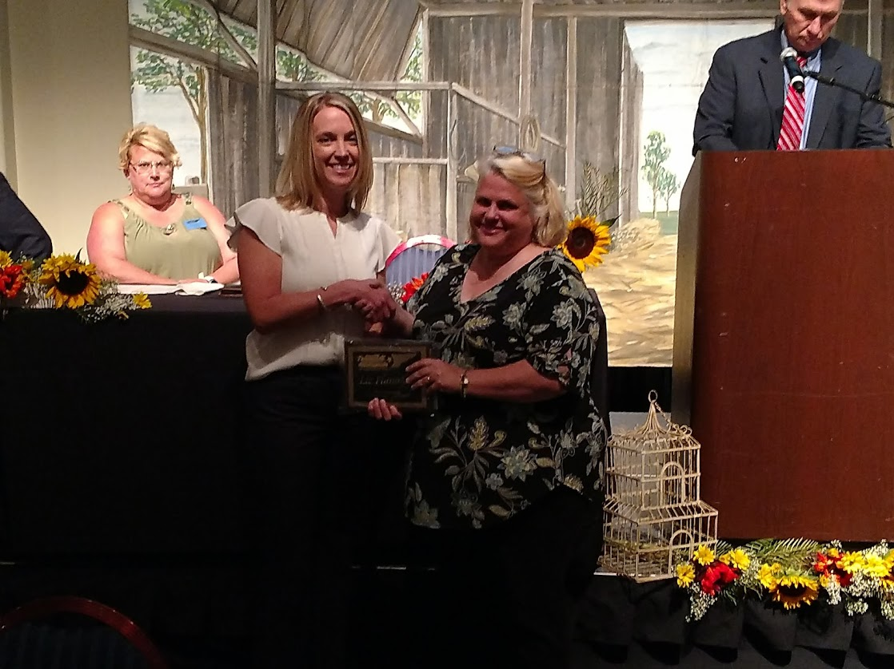
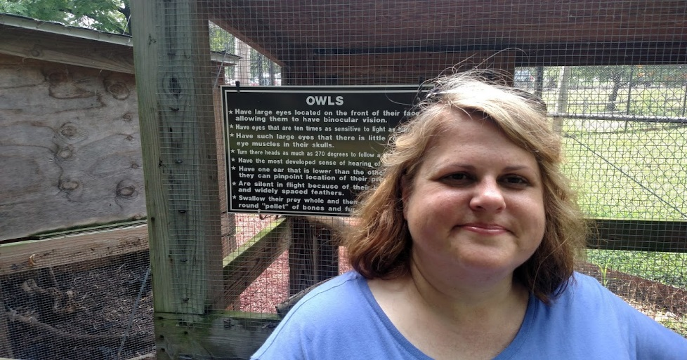
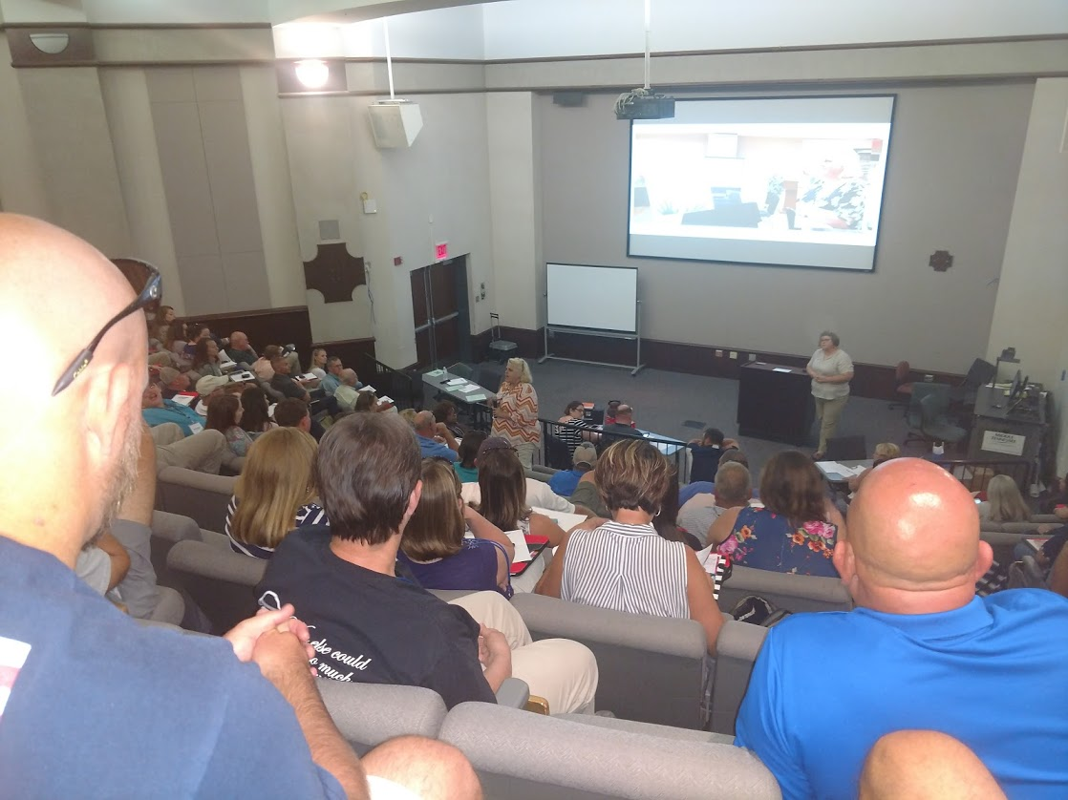
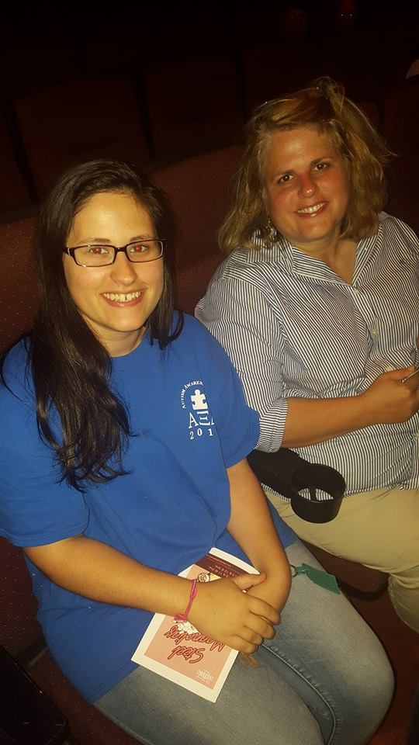
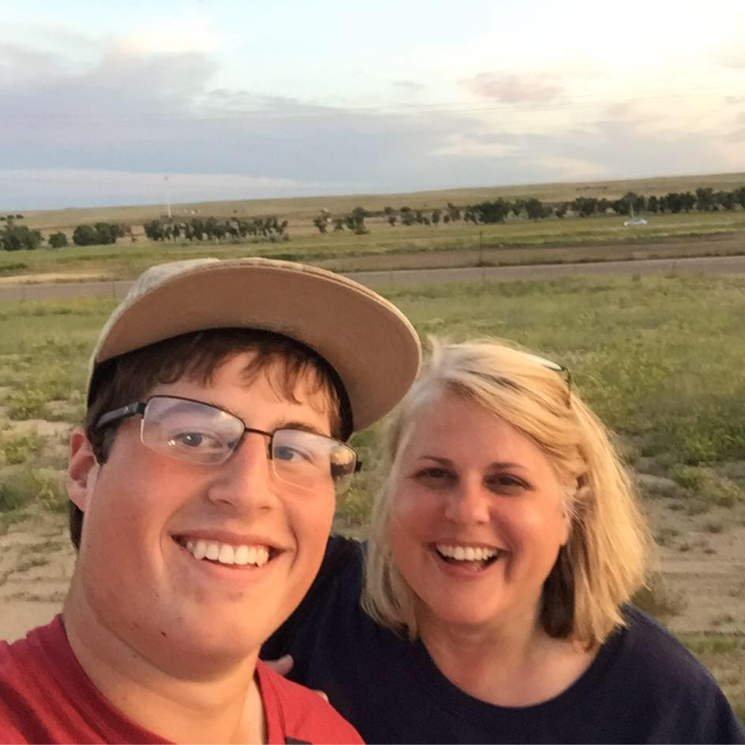
Mrs. Liz Flanagan

Slide 7
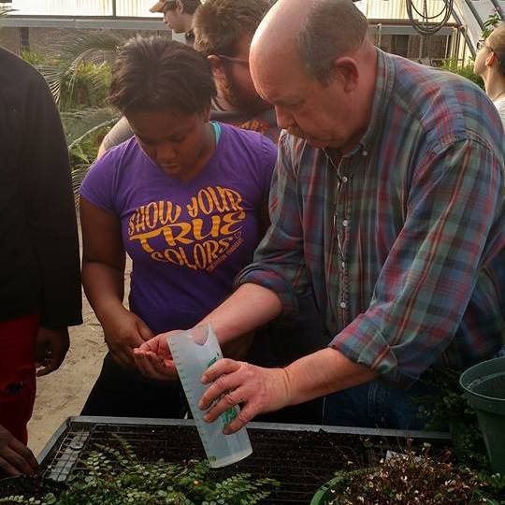
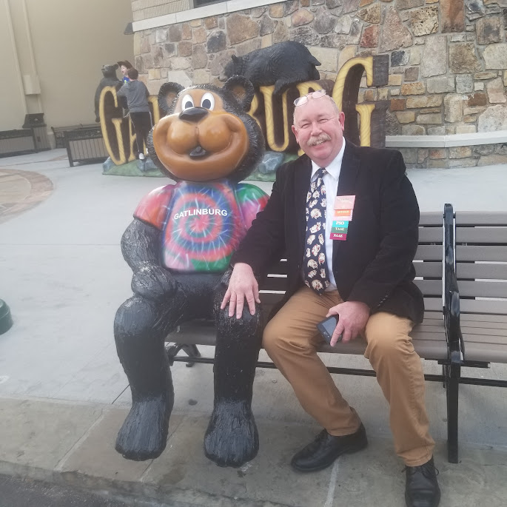
Mr. Bryan Cole

Slide 8
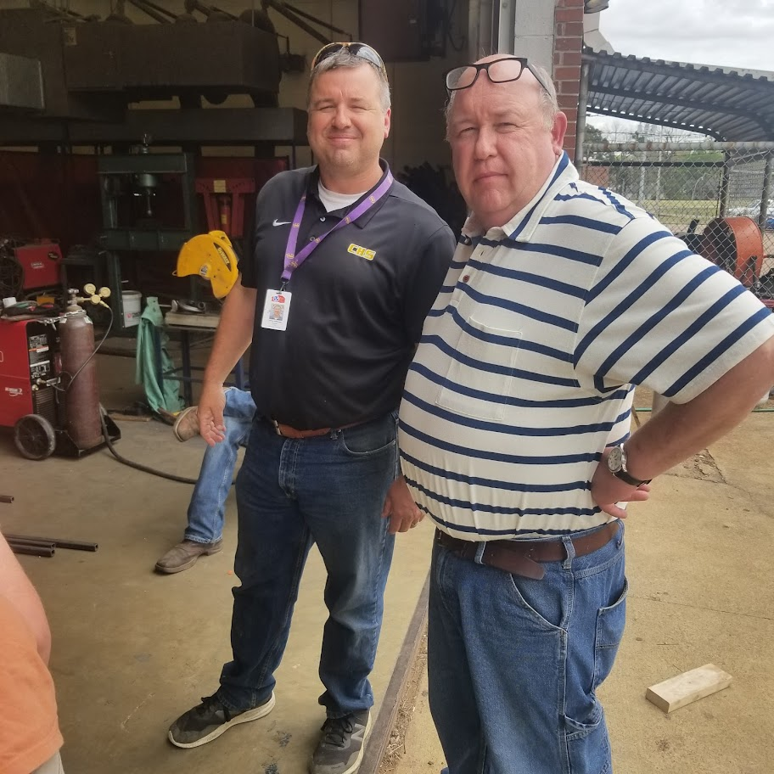
Mr. jerry Johnson

Slide 9
Career Development events
EACH YEAR THE COVINGTON FFA PARTICIPATES IN NUMEROUS CAREER DEVELOPMENT EVENTS (CDE’S) OR CONTEST
MR. JOHNSON HAS BEEN KNOWN TO HELP THOSE WHO HELP THEMSELVES BY PARTICIPATING IN THESE CONTEST (HINT, HINT, WINK, WINK)

Slide 10
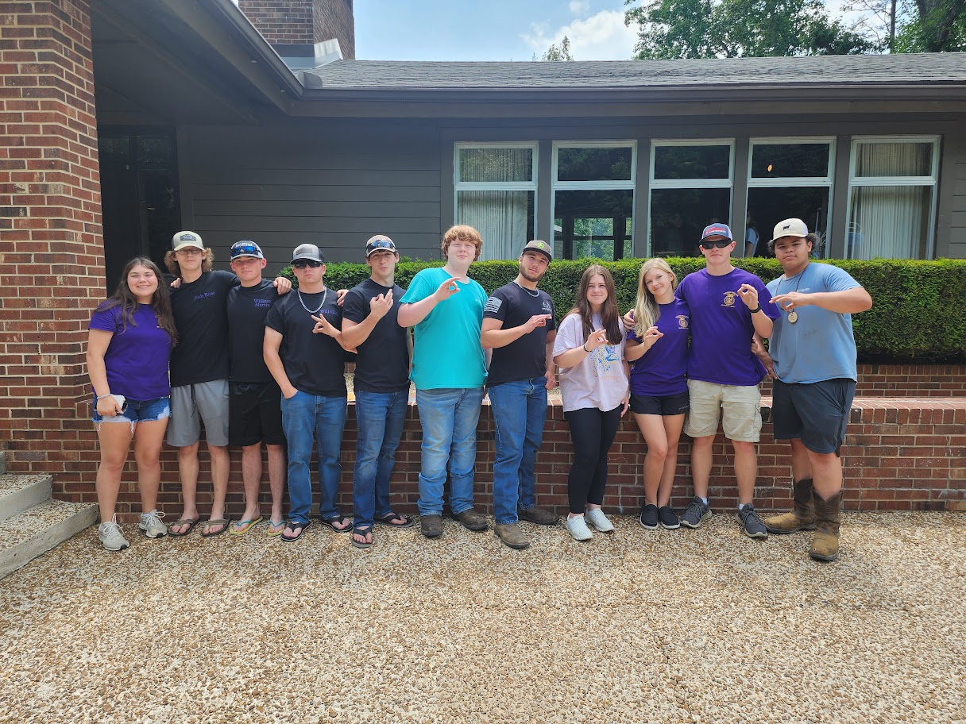
CDE’s
Here are a list of the Competitions that we are competing in for the 2023-2024 School Year.

Slide 11
faLL cde’S FOR COVINGTON FFA
SOIL JUDGING- (LEXINGTON SEP 19th, Milan Oct 3rd, STATE IS OCT 16th at Middle TN)
HORSE JUDGING- (Regional Sept 18th at UTM MTSU STATE NOV 14th)
AG SALES and Marketing Plan-(October 19th at Jackson; State at Gatlinburg)
LIVESTOCK JUDGING- (REGIONAL NOV 7th, PARSONS NOV 9th)
PARLIAMENTARY PROCEDURE/OPENING AND CLOSING- (MUNFORD Nov 15^{th,} Dyersburg High DEC 5th and 7th)

Slide 12
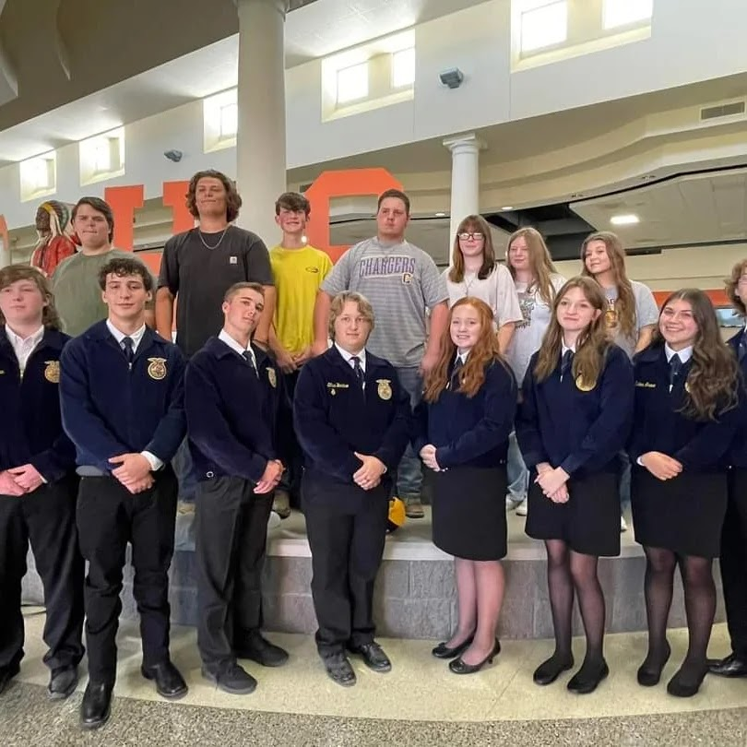
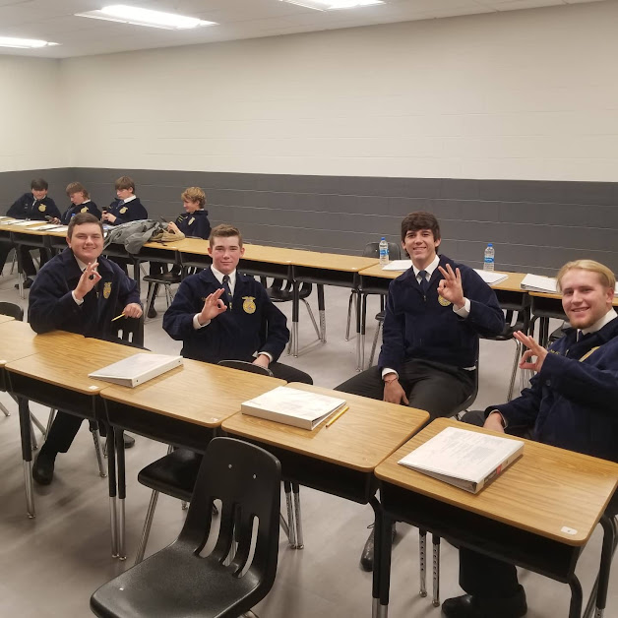
Fall cde’S
Marketing Plan: 4th in West TN
Ag Sales: 5th in West TN

Slide 13
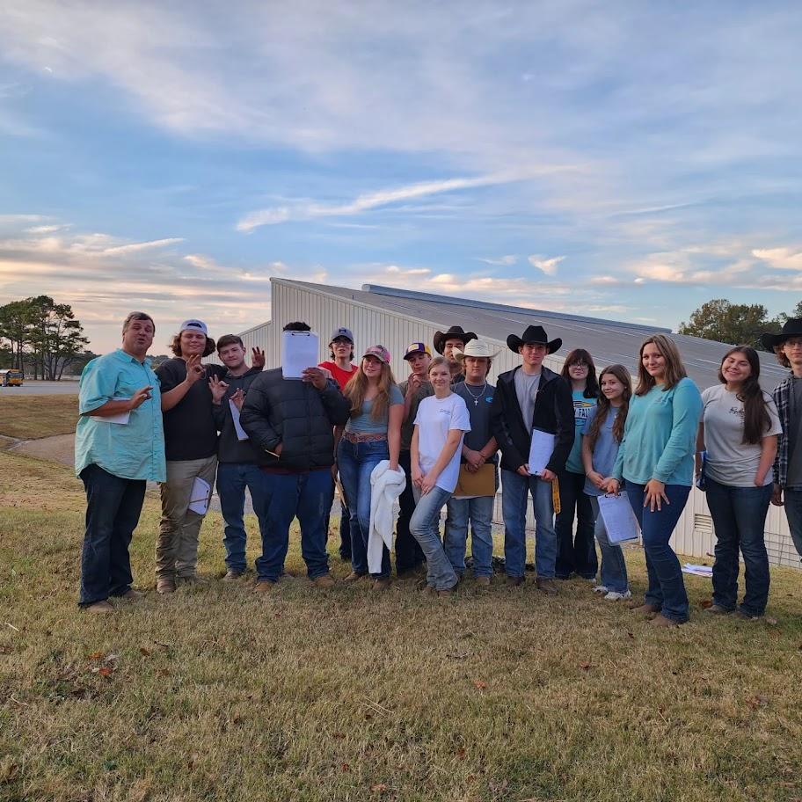
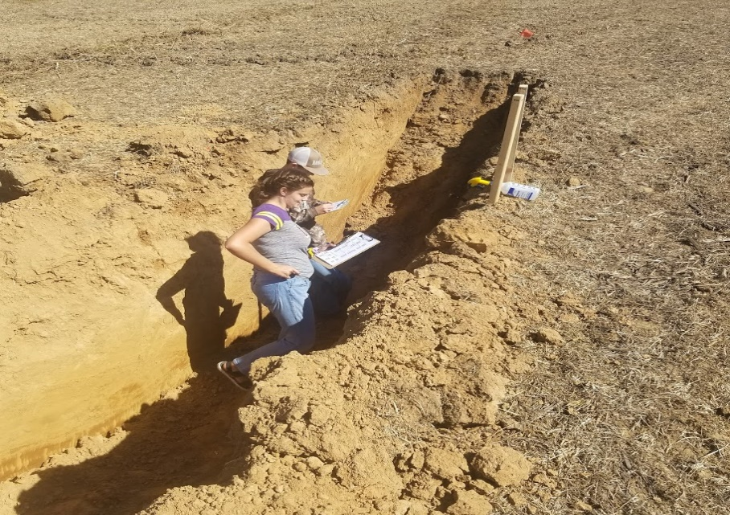
FALL CDE’s
Livestock Judging:9th in West TN
Soil Judging: 2022 State Champions; 31st in the Nation out of 105 teams

Slide 14
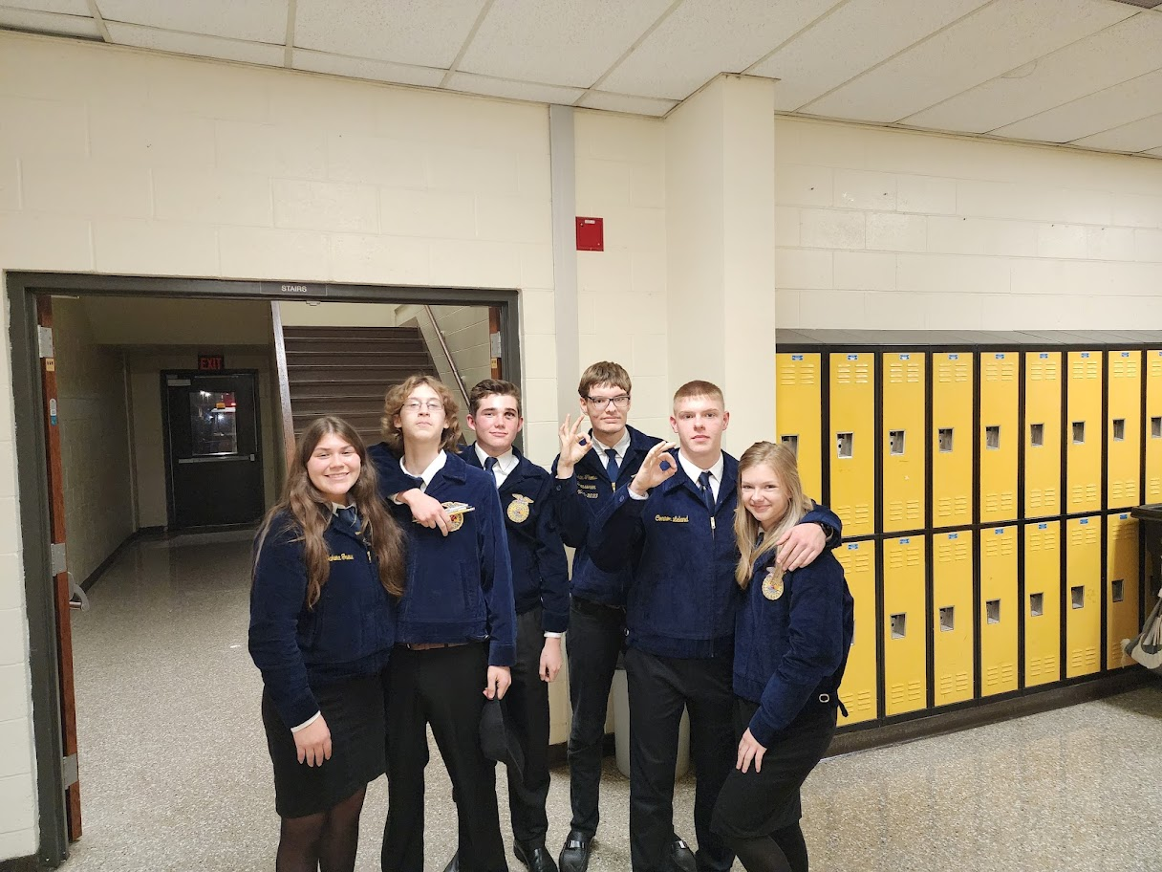
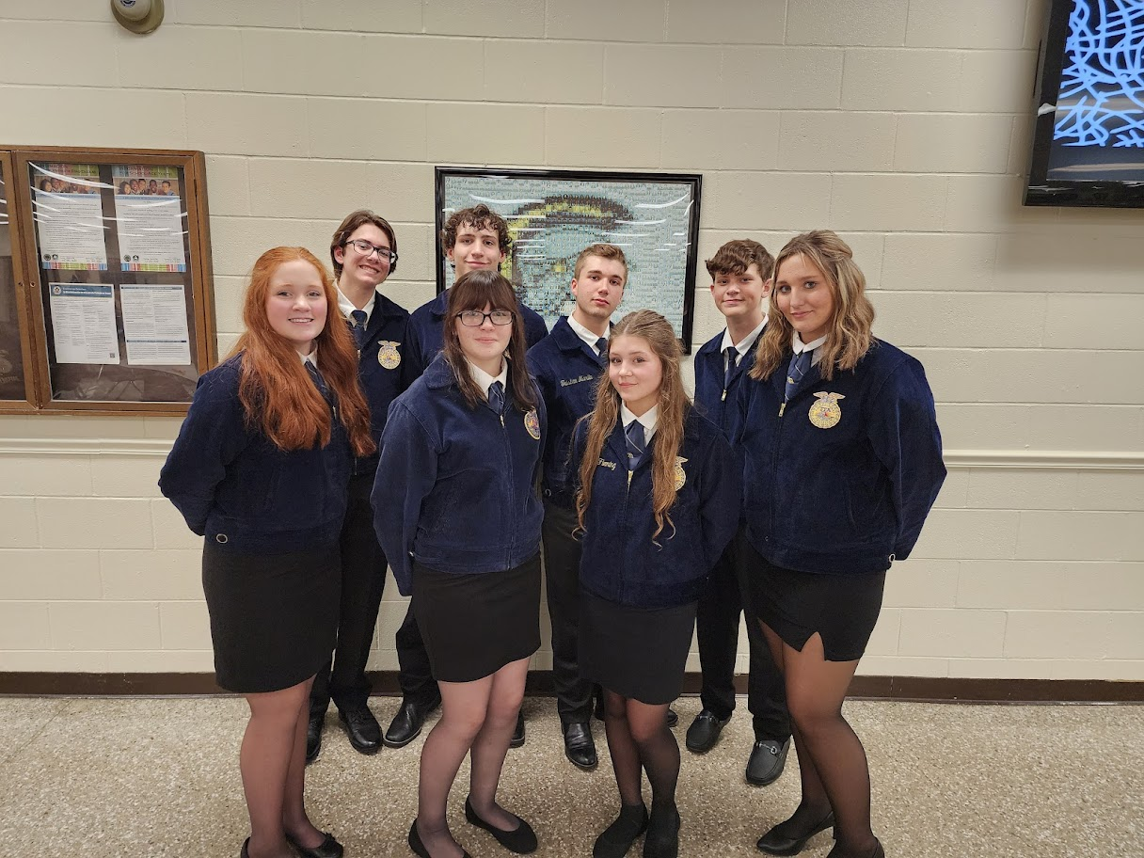
FALL CDE’s
Horse Judging: 7th in West
Tn
Parliamentary Procedure: 8th in West TN. CCM: 8th in West TN

Slide 15
Winter CDE’s
AG COMMUNICATONS and AG ISSUES-UTM (Jan 23rd and 30th)
Prepared, Job Interview, FFA CREED and Extemporaneous Public Speaking-TRENTON (Feb 2nd CROCKETT COUNTY FEB 6th AND 8th)
AGRICULTURE MECHANICS-HAYWOOD COUNTY (MARCH 5th)
STATE AG MECHANICS IS April 26th AT TENNESSEE STATE UNIVERSITY

Slide 16
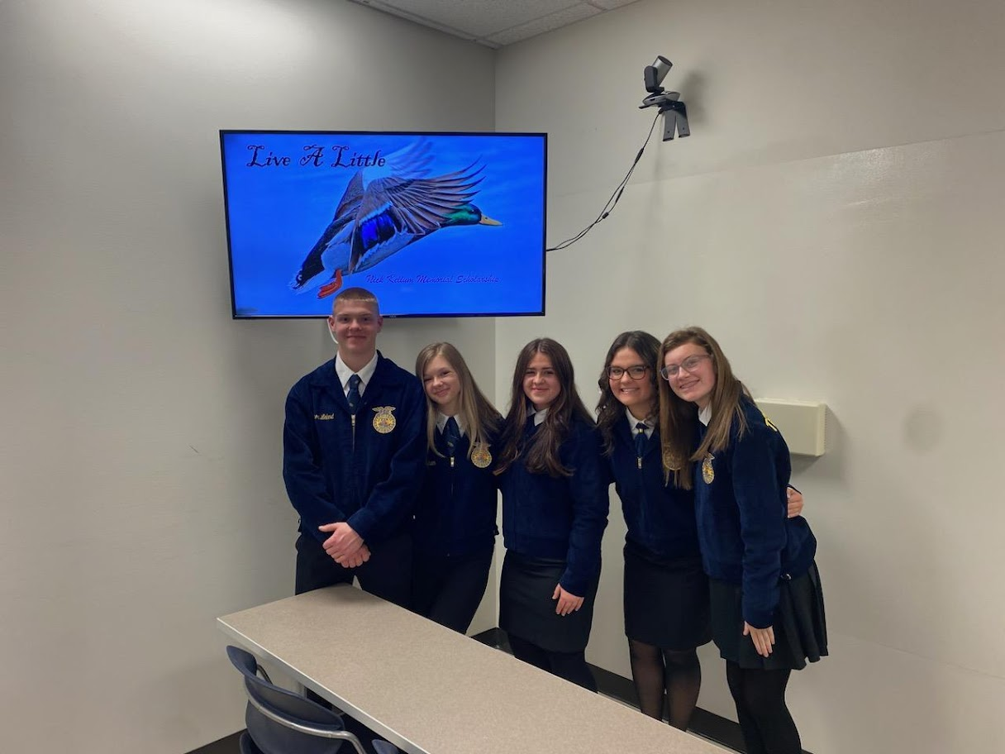
WINTER CDE’s
Ag Communications: 3rd in West TN

Slide 17
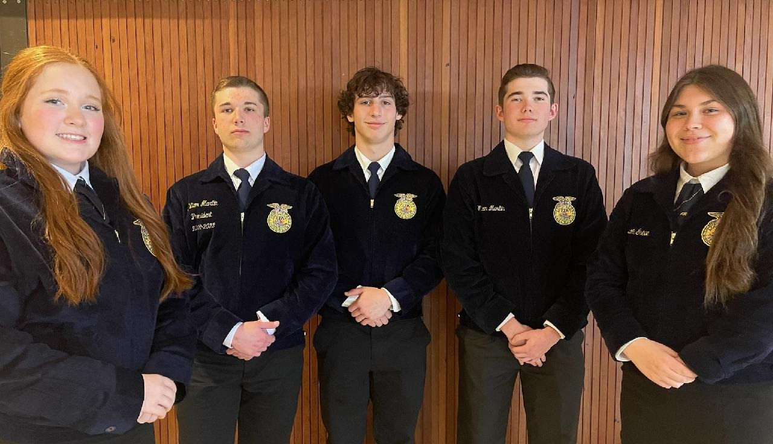
Winter CDES
Prepared Public Speaking: 9th in West TN
FFA Creed: 9th in West TN
Job Interview: 9th in West TN
Extemp Speaking: 6th in West TN

Slide 18
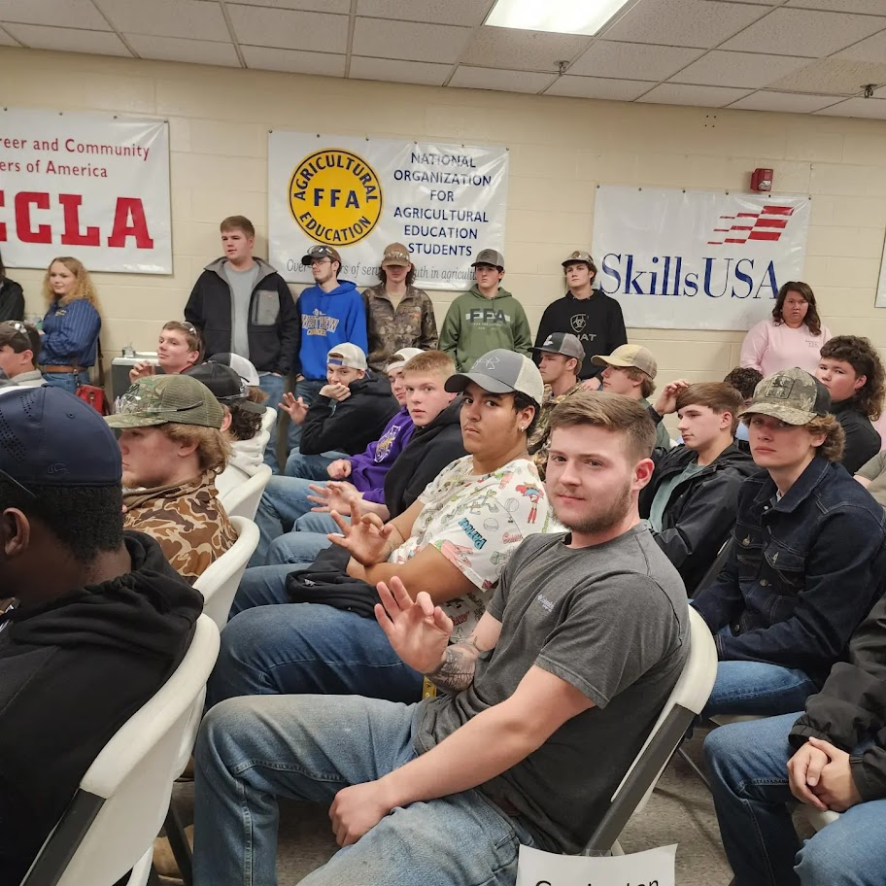
Winter CDE’s
Agriculture Mechanics: 2nd in West TN (Lower) and 6th in West TN (Upper)

Slide 19
SPRING CDE’s
FLORICULTURE AND NURSERY-JACKSON STATE (APRIL 6th^{TH}) STATE @ TENNESSEE TECH (APRIL 11TH)
POULTRY JUDGING- (REGIONAL April 4th, STATE IS APRIL 11th @ Tennessee Tech)
FORESTRY-FORT PILLOW (APRIL 27th) STATE AT CAMP CLEMENTS (JUNE 2-3)
FOOD SCIENCE, DAIRY FOODS, AND MEATS (State Convention 2023)
ENVIRONMENTAL AND NATURAL RESOURCES MANAGEMENT AND AGRONOMY-JUNE 3rd AT CAMP CLEMENTS

Slide 20
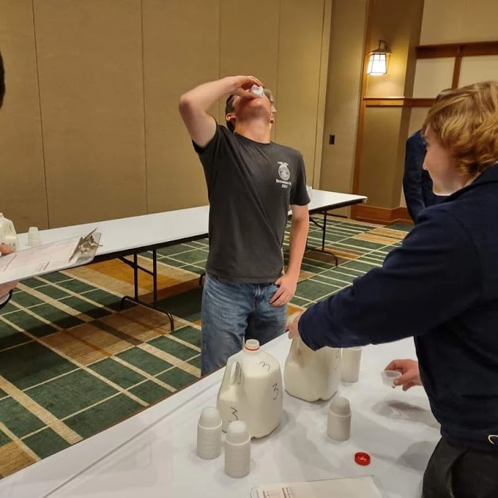
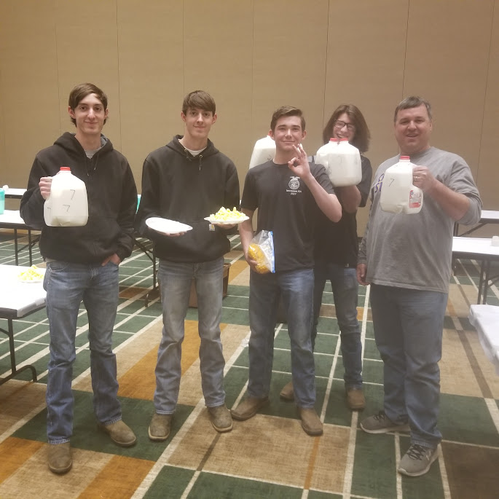
SPRING CDE’S
Poultry: 2022 West TN Champions 4th in State
Dairy Foods: 2022 TN State Runner Up, West TN Milk Champions

Slide 21
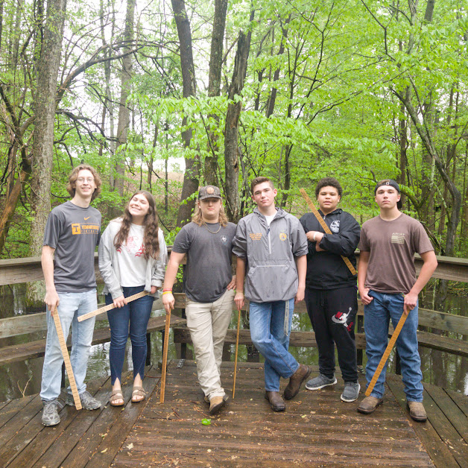
Spring cde’s
Food Science: West TN Regional Winner, 7th in State 2022
Forestry: 7th in West TN 2022

Slide 22
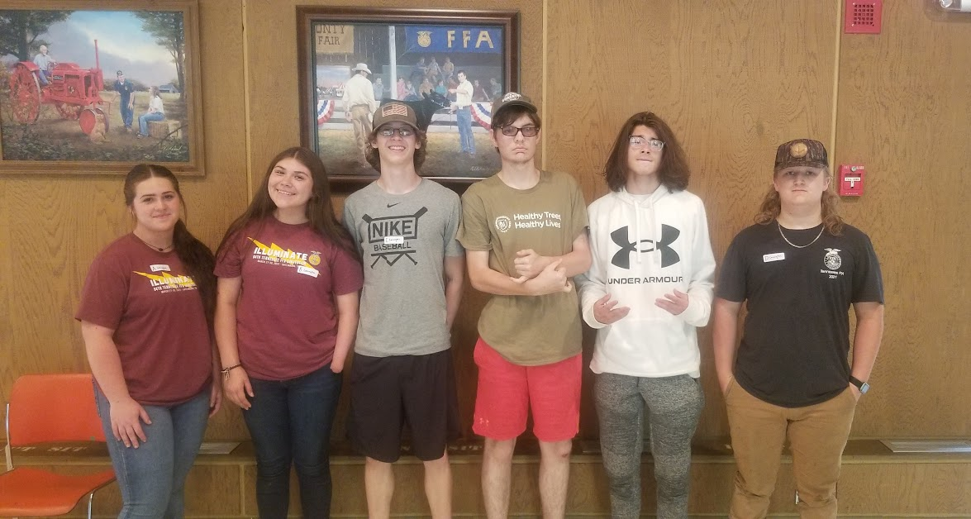
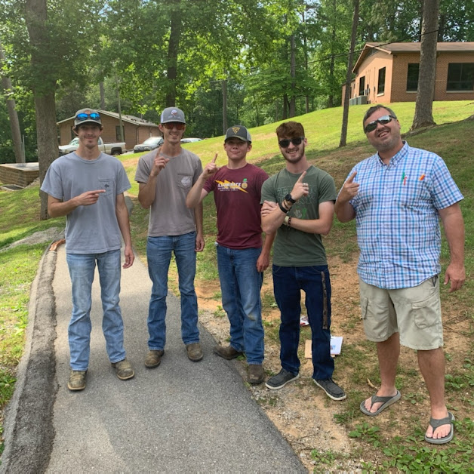
SPRING CDE’s
Environmental and NRM: 4th in State 2022 West TN Champions
Agronomy: 2022 State Champions Will compete this fall in Indianapolis

Slide 23
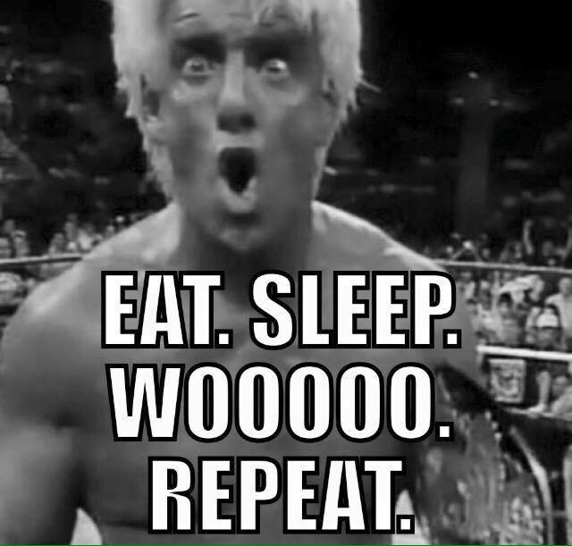
NEW CDE’s
Ag Issues (Mrs. Flanagan)

Slide 24
Leadership Activities
MR. JOHNSON “THAT WAS WAY COOL DUDE…………………BUT, I AM NOT THE BIGGEST FFA COTNEST DOER.COM PERSON” WHAT ELSE DOES FFA HAVE FOR ONE?
LETS LOOK AT LEADERSHIP ACTIVITES

Slide 25
Leadership activities
NATIONAL FFA CONVENTION- INDIANAPOLIS, INDIANA (Oct 31-Nov 4)
STATE FFA CONVENTION-GATLINBURG, TENNESSEE (MARCH 23-27th)
CAMP CLEMENTS-(JUNE 2024)
CHAPTER OFFICER RETREAT-(Lebanon, TN)
IMPACT LEADERSHIP CONFERENCE AT CAMP CLEMENTS (NOV 18TH AND 19th)

Slide 26
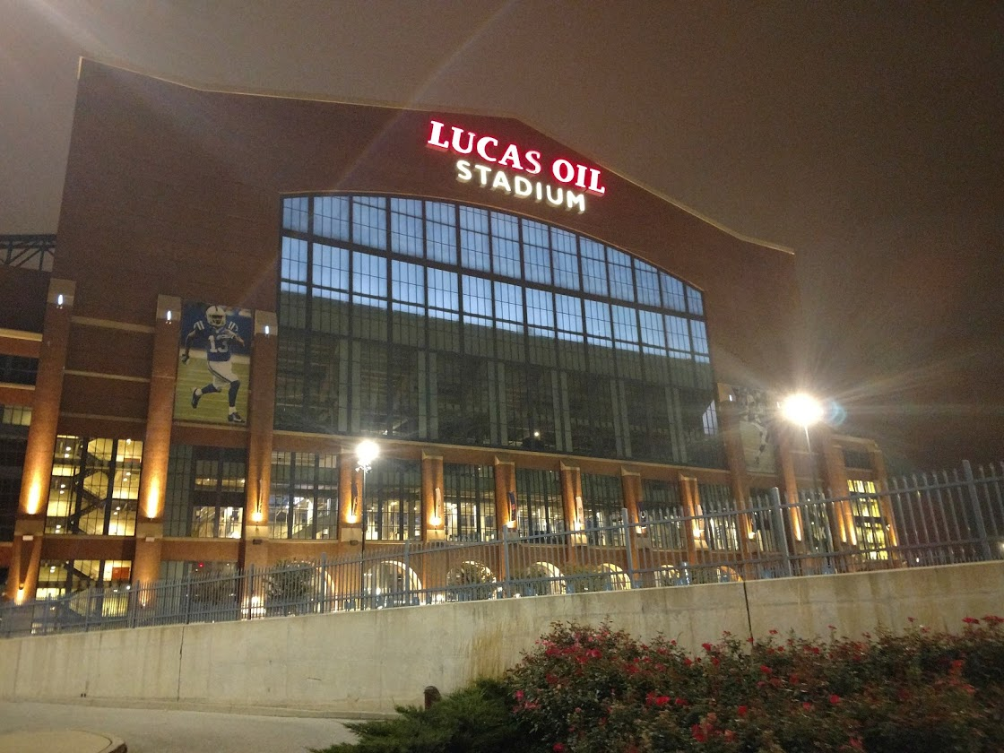
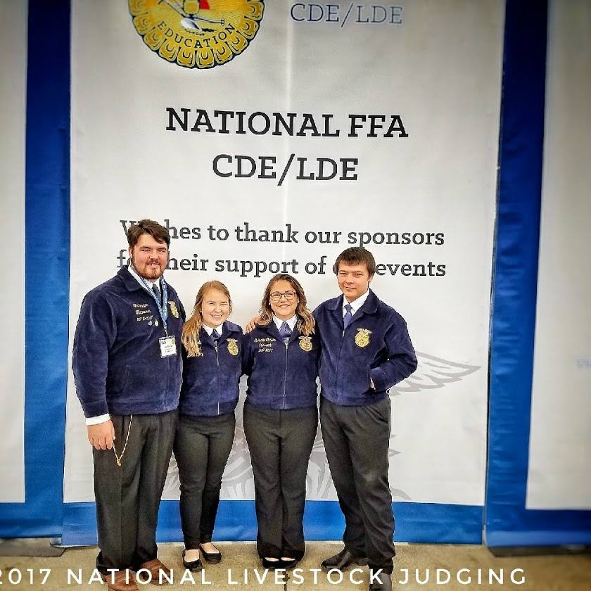
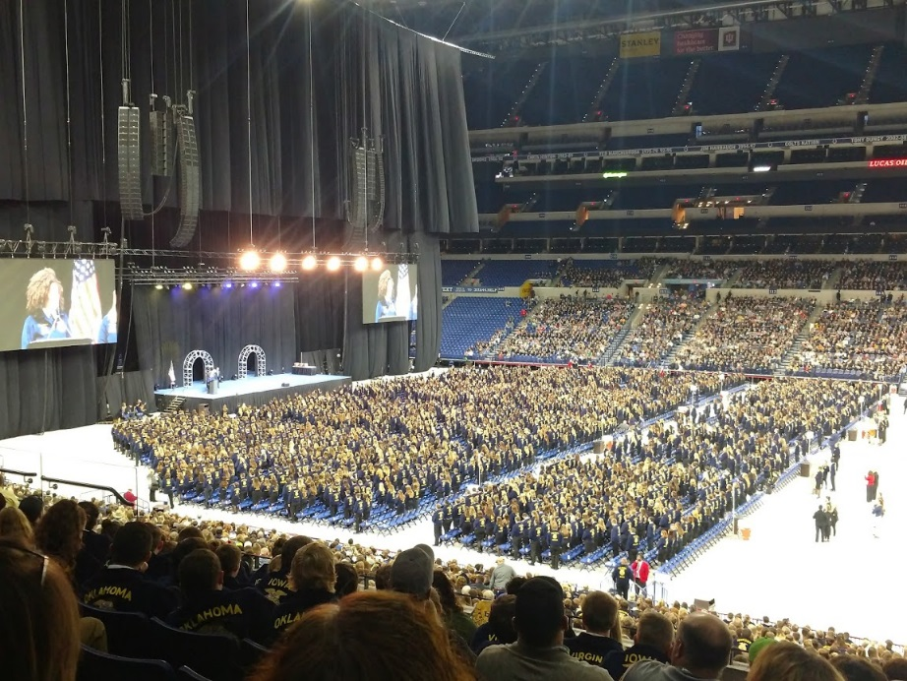
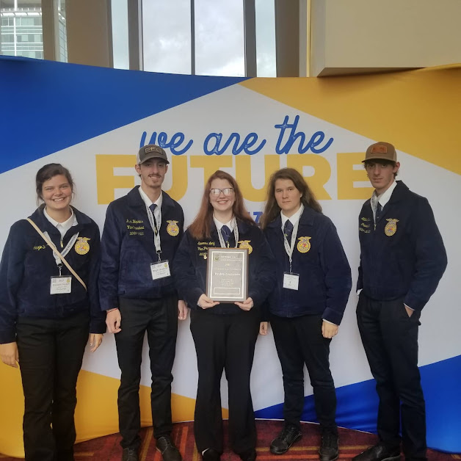
NATIONAL FFA CONVENTION

Slide 27
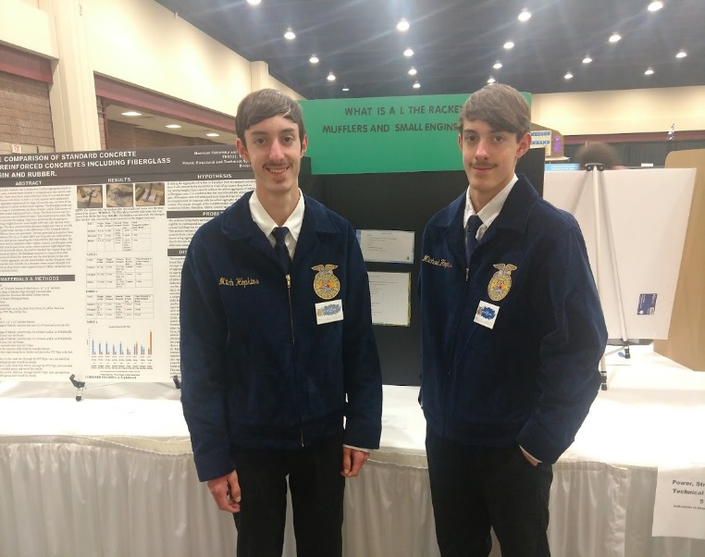
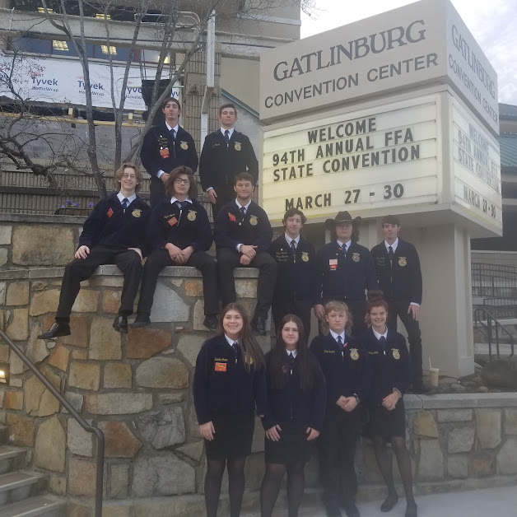
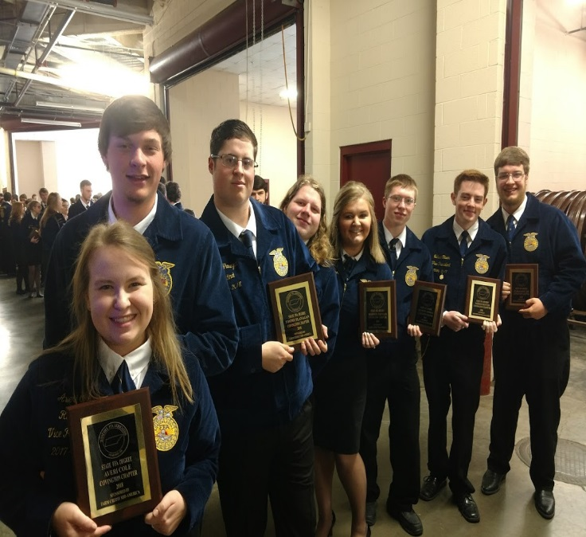
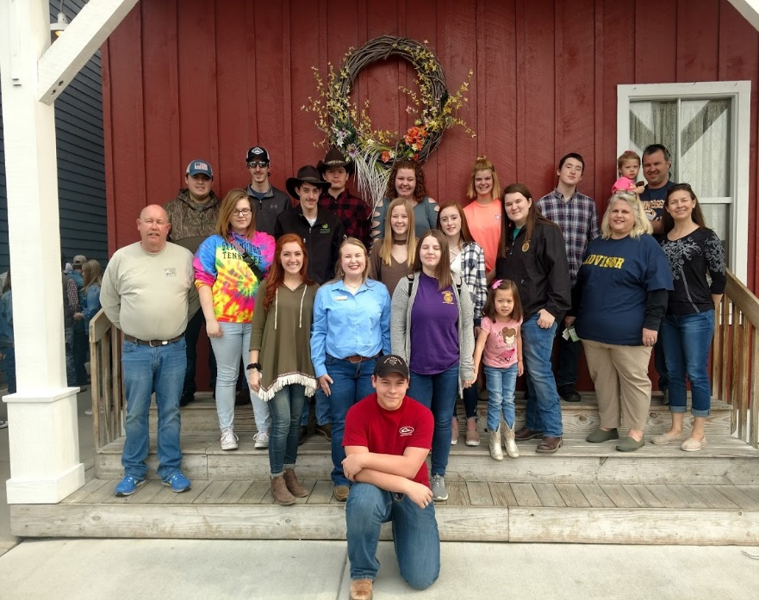
State FFA Convention

Slide 28
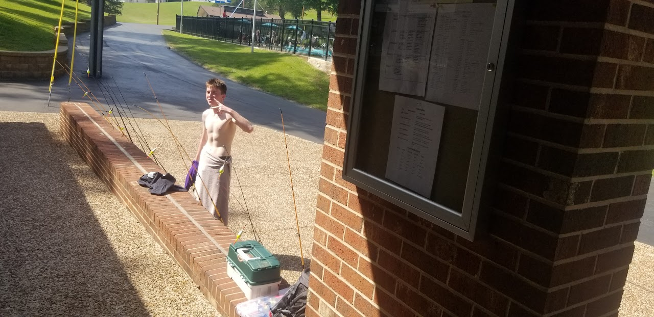
CAMP CLEMENTS 2023

Slide 29
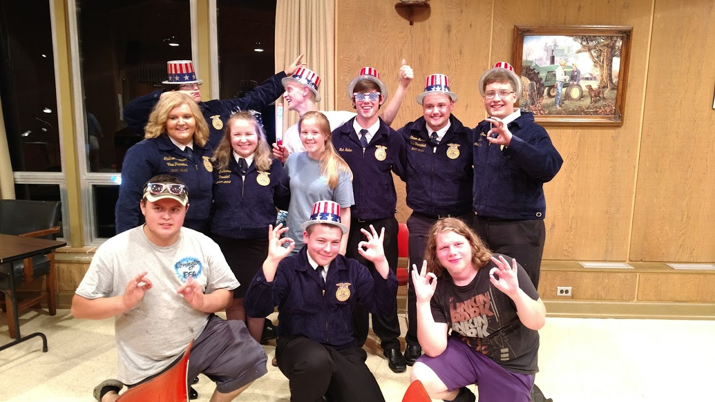
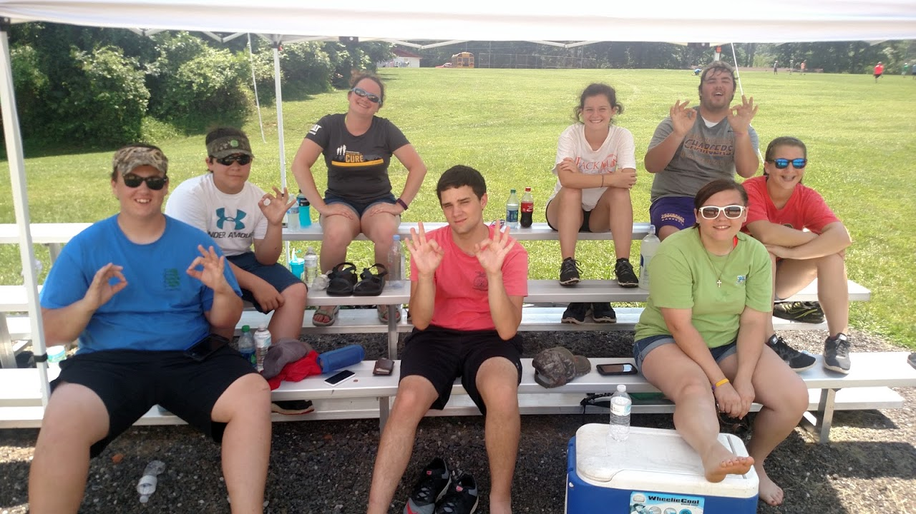
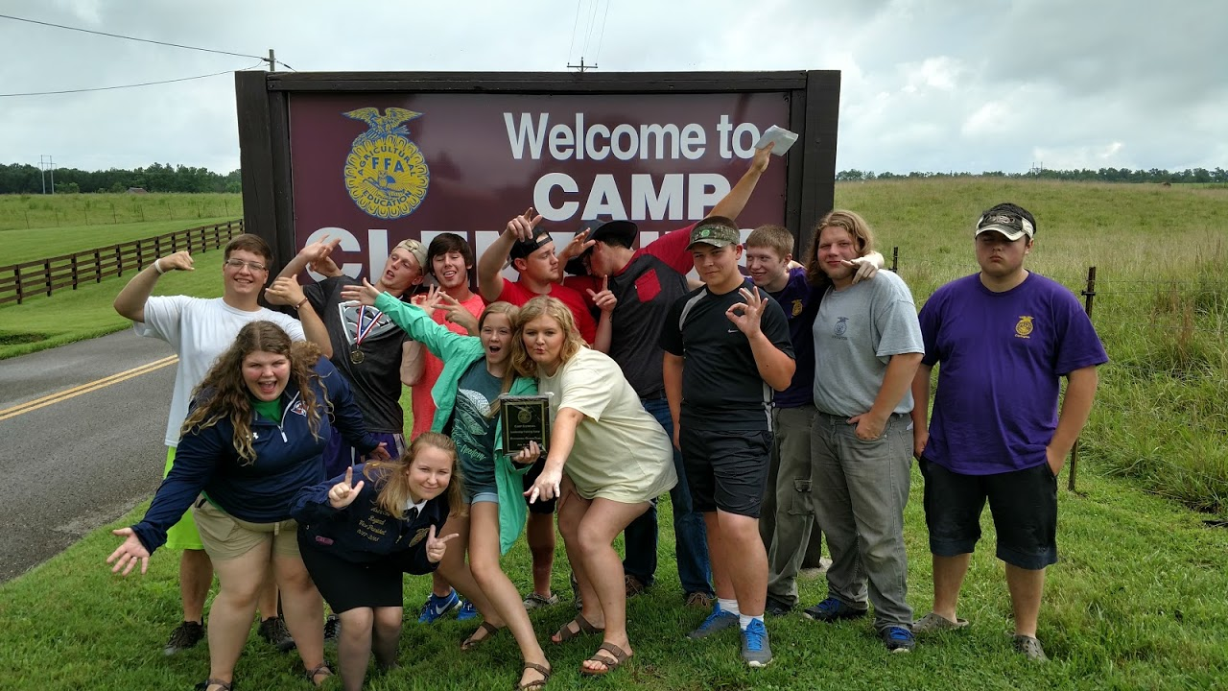
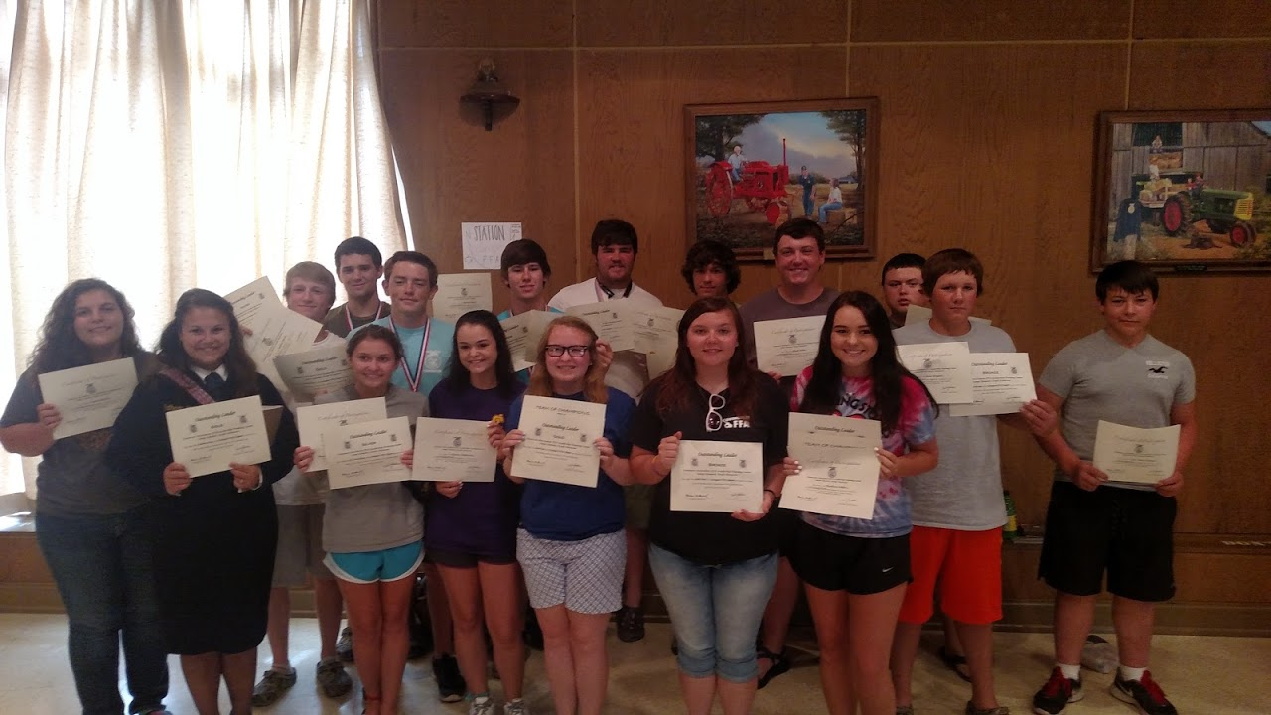
CAMP CLEMENTS Past

Slide 30
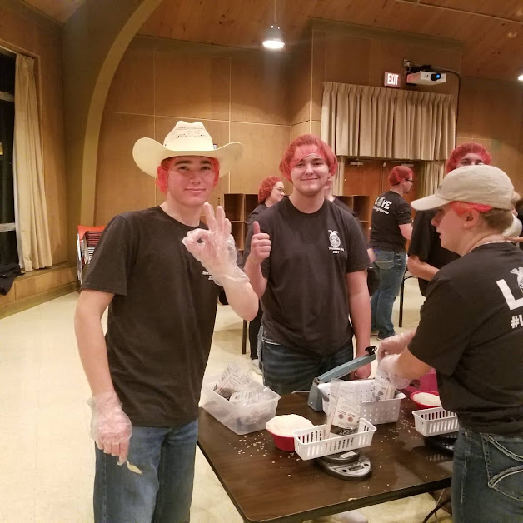
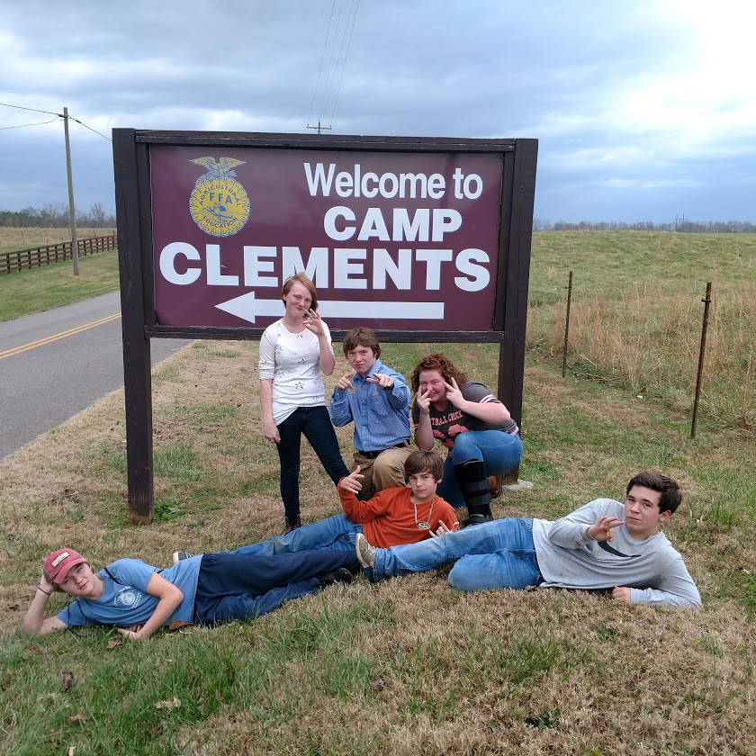
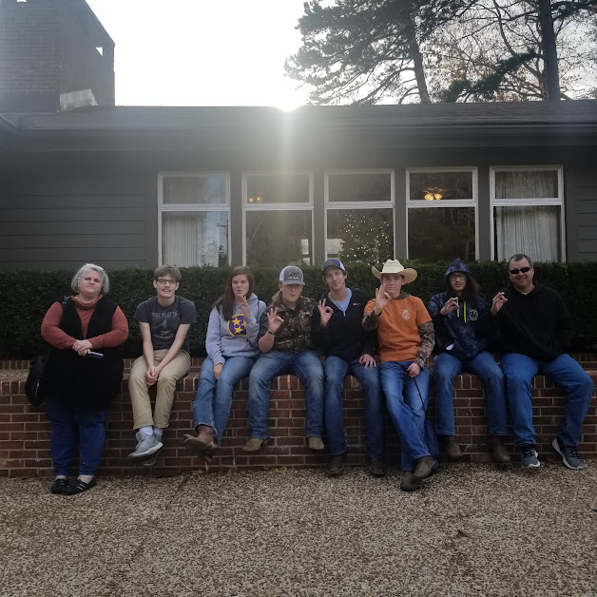
Impact Leadership conference

Slide 31
Livestock showing
“Mr. J, that was amazing……..truly amazing, you must be the most interesting man in the world with all those cool leadership stuff things you were saying. I want to do something where I get dirty and have a lot of fun!!
Livestock Showing is your calling then.
Our chapter has one of the stronger market lambs programs in West Tennessee as well as students who exhibit breeding sheep CHECK IT OUT!!!!!!!!!
AG BARN 2023-24

Slide 32
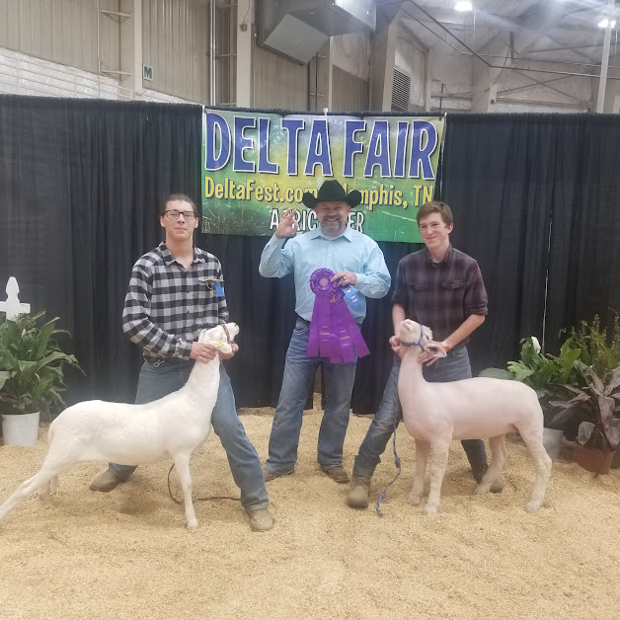
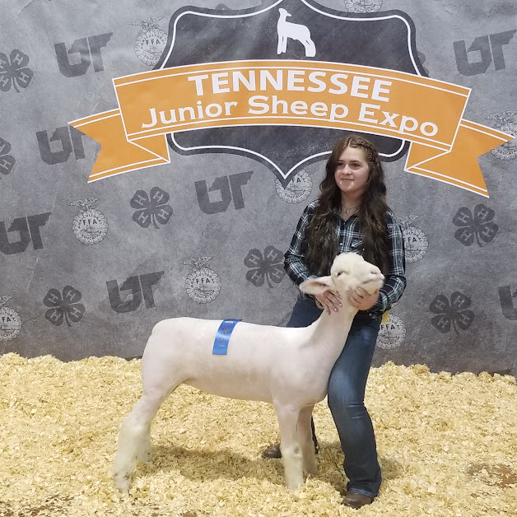
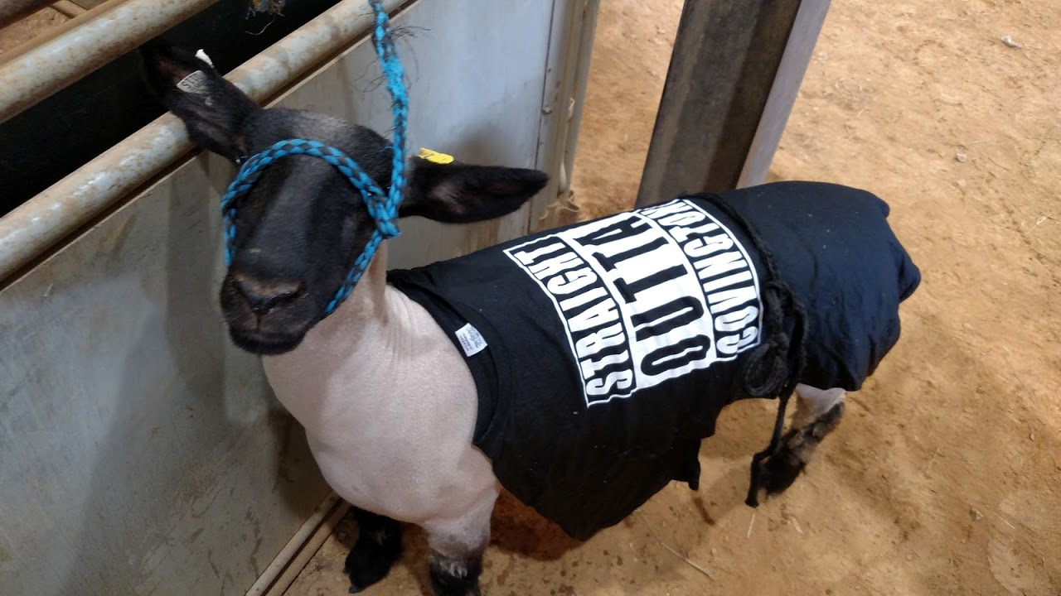
Livestock showing

Slide 33
Fun activities
“TOTALLY GNARLY…………BUT I PUT ON FOR MY CITY MR. J………NOT FOR THESE OTHER CATS….TELL ME SOME FUN ACTIVITES WHERE I CAN GET MY GROOVE ON.”
LETS TAKE A LOOK

Slide 34
FUN Activities
BACK TO SCHOOL FUN ACTIVITY- Tailgate vs Brighton August 25th
MOVIE NIGHT-OCTOBER AND FEBRUARY
HAYRIDE-OCTOBER
MID-SOUTH FARM AND GIN SHOW-MARCH 3, 2023
BREAD OF LIFE FOOD PANTRY-EVERY OTHER THURSDAY AT 1ST UNITED METHODIST CHURCH
COMMUNITY SERVICE PROJECTS THROUGHOUT THE YEAR!!!
FFA OLYMPICS
DOWN ON THE FARM CAMP

Slide 35
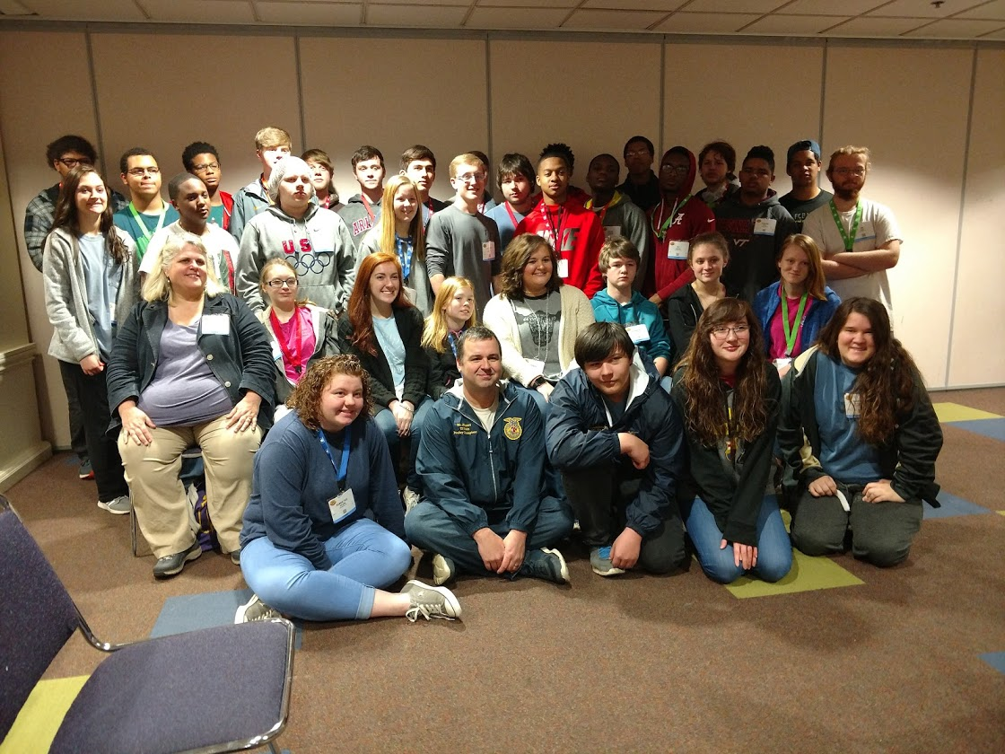
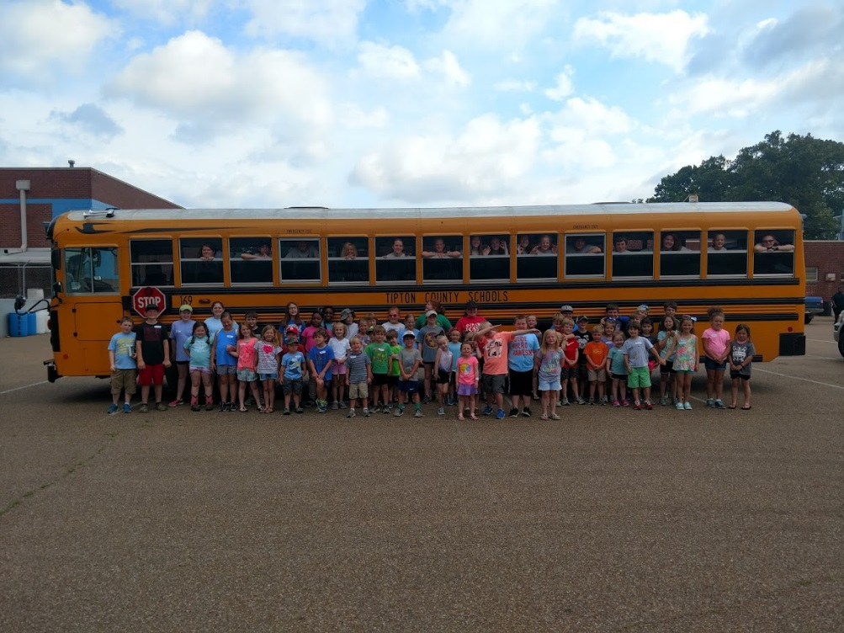
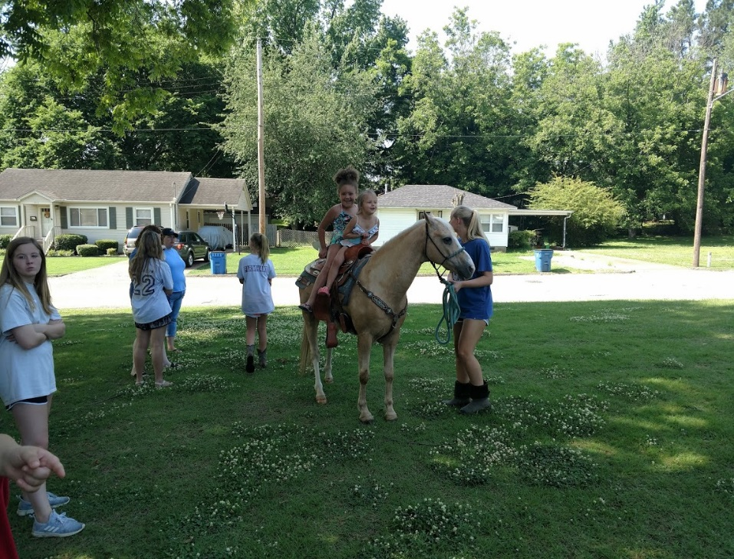
FUN ACTIVITIES

Slide 36
Ffa Week Activities
FFA WEEK OCCURS IN FEBURARY
HERE ARE SOME OF THE ACTIVITES THAT THE OFFICERS ARE PLANNING
TUESDAY-TOUGH GUY TUESDAY, FACULTY BREAKFAST, GOODWILL TOUR AT UTM
WEDNESDAY-WONDERFUL CAMO WEDNEDAY, BOWLING NIGHT, FFA OLYMPICS
THURSDAY-FFA OLYMPICS
FRIDAY-MUDDY SOMETHING DAY, FFA COOKOUT

Slide 37
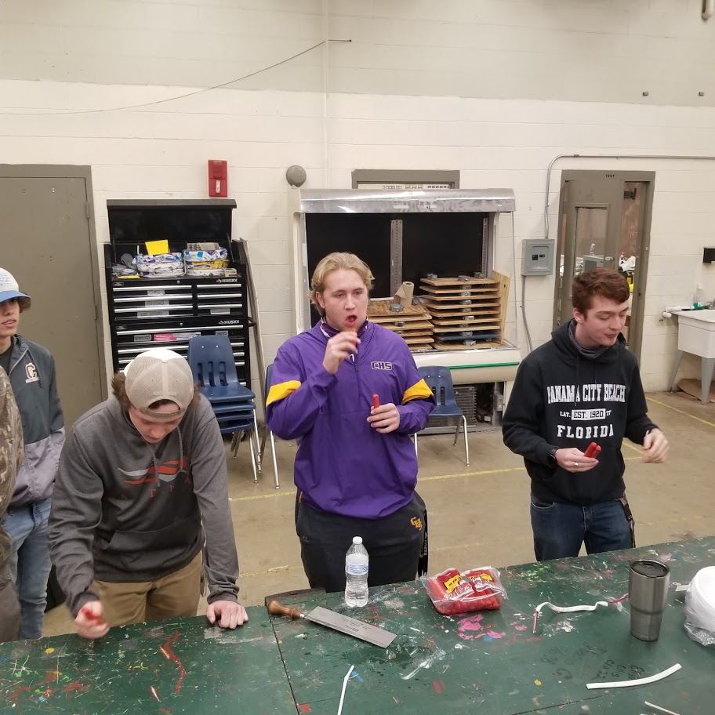
FFA WEEK

Slide 38
Fun Activities
MR. JOHNSON IS ALSO PLANNING FOR HIS CLASSES (MUST BE IN FFA, hint, hint, wink, wink)
AG MECHANICS/DIGITAL AGRONOMY/WELDING- NATIONAL FARM AND MACHINERY SHOW (FEB 2023) (LOUISVILLE, KY)
WILDLIFE MANAGEMENT/FOOD SCIENCE—REELFOOT LAKE STATE PARK (TIPTONVILLE, DECEMBER 9TH)

Slide 39
Final thoughts
SO, AT THIS POINT, YOU ARE PROBARLY SAYING ONE OF THREE THINGS TO YOURSELF
“MR. J, I AM IN LIKE FLIN”
“MR. J, LET ME THINK ABOUT IT” or
“MR. J, JUST SHUT THE %#$* UP”
HERE IS A FINAL THOUGHT

Slide 40
Final Thoughts
WHAT YOU MAY NOT HAVE REALIZED THAT AS THE TEACHER I AM GOING TO DO WHATEVER IT TAKES TO MAKE SURE THAT YOU ARE SUCCESSFUL IN THIS CLASS AND BEYOND THESE WALLS. YOU HAVE A TEACHER THAT WILL GO TO BAT FOR YOU AND DO WHATEVER IS NECESSARY. KEEP THIS IN MIND AS YOU MAKE THE DECISION TO JOIN THE FFA OR NOT

Slide 41
THAT’S ALL FOLKS!!!!!!!!!!

