Slide 1
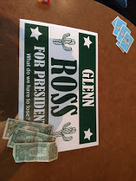
Ag Sales 101-Inman and JJ Style
Ryan Inman-Henry county High School
Jerry Johnson-Covington high School

Slide 2
When Inman and JJ aren’t drinking milk, hugging trees, and saying woo…..

Slide 3
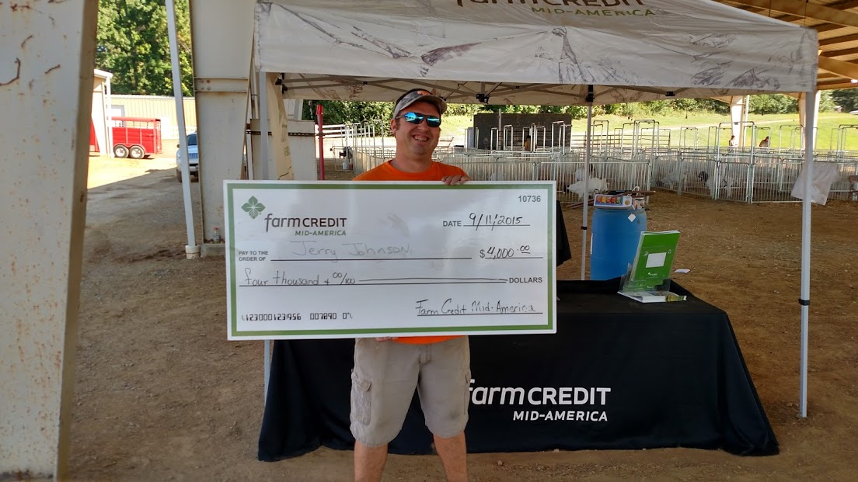
We are doing Agriculture Sales!! #makingsalesgreatsincetheychangedtherulesafewyearsago

Slide 4
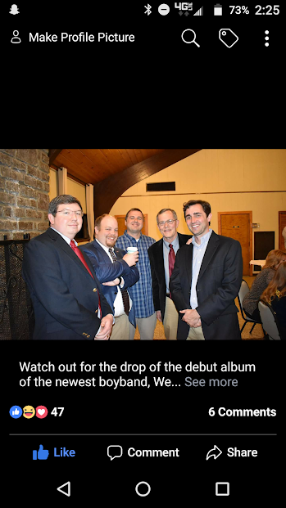
How do you get a student excited about Ag Sales?
GOLDEN RULE= WE ALL SELL SOMETHING, FROM THE TIME WE GET UP UNTIL THE TIME WE GO TO BED (unless you have to sleep in the bed with the Lorax, then you try not to sell anything ;)
AG SALES and JOB INTERVIEW may be the two most important CDE’s that we as teachers teach. As a CDE coach of many competitions, we value each and every one of them. However, these two may be the most important in the fact that every single one of our students are going to be doing at least two things in their lives after school-interviewing for a job and selling!
This CDE allows the student to learn that through hard work and determination, you can learn the sell process which is vital in any career field that he or she may pursure.

Slide 5
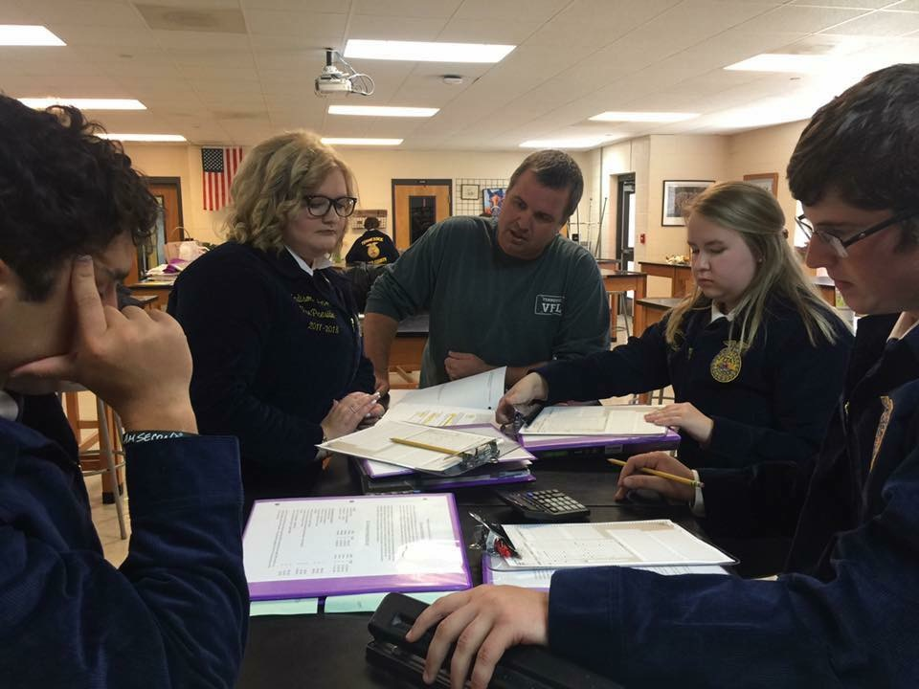
STEP 1= TEST
The test is worth 35% (34.7826) of the Ag SALES Contest
It makes it a VITAL PART of the contest, that can easily be handled under the tutelage of you
A goal of 92 is the minimum if you are serious at playing at a regional or state level
Last five years of the national AG SALES CDE

Slide 6
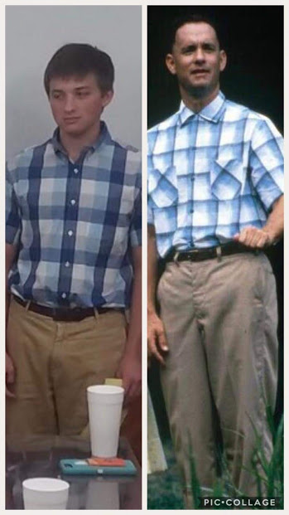
STEP 2=FOLLOW THE RUBIC ON THE TEAM ACTIVITY (13% of contest)
Follow the rubric on tnffa.org (FOR ALL OF YOUR FFA NEEDS)
Profile of one or two customers • The team will then develop the pre-call plan (for the product(s) provided prior to the event) necessary to sell the product(s) in a face-to-face sales call. This pre-call plan should include: • Potential questions to build rapport for the scenario. • Common interests that team members have with the customers. • Identify questions that help determine the wants and needs of the customer. • Identify active listening skills or techniques for determining needs and wants. • Identify and match potential needs and wants of the customer to the products’ features and benefits. • Identify potential objections of the customer. • Identify potential concerns of each customer

Slide 7
STEP 3-Indvidiual Interview (52 % of the Contest)
First Impression!
Personal Rapport
Clarifying Questions (Learn about Business and Confirm Preliminary Questions)
Needs and Wants
Features and Benefits
Matching Needs and Wants
Trial Questions

Slide 8
STEP 3-Indvidiual Interview (52 % of the Contest)
Objections
Addressing Objections
Close or Advance Sale (Have to make the attempt!!)
Active Listening

Slide 9
That’s all Folks!!!

